Slide 1



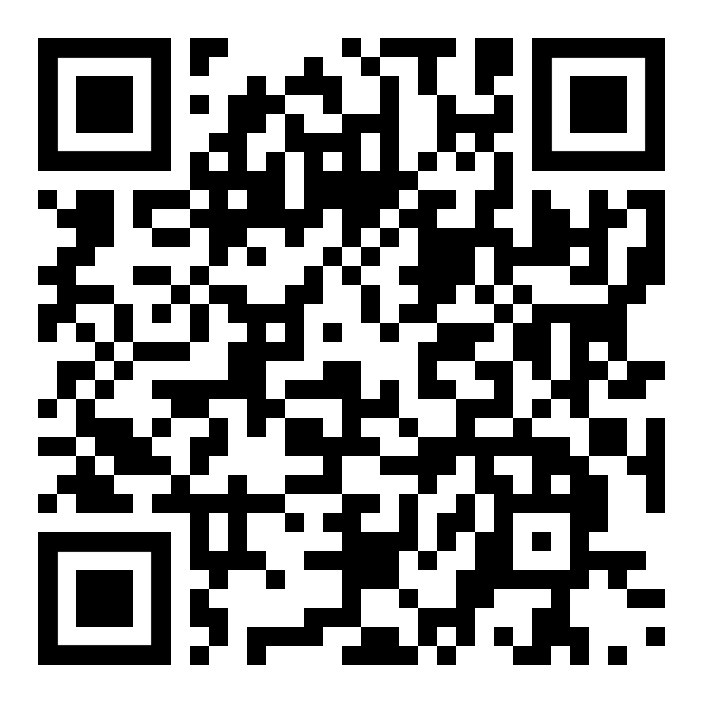
Problematic social media use led to greater sleep disturbances, which then led to greater
depressive symptoms.
Sleep Disturbance as a Mediator Between Social Media Use and Depression in U.S. College Students
PRESENTER
Natalie Blackman
Background
College students are a vulnerable population, with over 60% meeting criteria for one or more psychological health problem (Lisbon et al., 2022).
Heavy social media use can increase stress, anxiety, depression, and impair overall impaired health (Li et al., 2023).
A study conducted in China found that social media use leads to daytime sleepiness, which leads to poor sleep quality, which leads to higher levels of suicidal ideation among college students (Ma et al. 2025).
The aim of the current study was to extend Ma et al.’s (2025) study by examining whether sleep disturbances mediate the relationship between problematic social media use and depressive symptoms among college students in the United States.
Method
Measures
Bergen Social Media Addiction Scale – Assesses social media addiction.
Higher scores indicate higher levels of addiction.
Pittsburgh Sleep Quality Index – Measures sleep quality.
Higher scores indicate higher levels of sleep disturbance.
Patient Health Questionnaire-9 – Assesses depressive symptoms.
Higher scores indicate greater levels of depressive symptoms.
Procedure
Undergraduate participants (n = 239) were recruited using Sona.
All participants completed a series of questionnaires online.
Sleep Disturbances
a = .04*
b = .96**
Results
The indirect effect of problematic social media use on depression through sleep disturbances was significant, b = 0.12, SE = 0.06, 95% CI [0.01, 0.24], p < .04.
Problematic Social
Media Use
Depressive
Symptoms
Discussion
Mediation analysis indicated that sleep disturbances significantly mediated the relationship between problematic social media use and depressive symptoms.
Interventions which target sleep may help mitigate negative mental health effects associated with social media use in college students.
These results can help inform campus-based mental health initiatives to increase awareness around the impact of social media on sleep and promote good sleep hygiene among students.
c’ = .29**
Note. *p < 0.01, **p <0.001
More Info
Faculty Mentor: Maureen Flynn, Ph.D.

