Slide 1
How to use Brainfuse

Slide 5
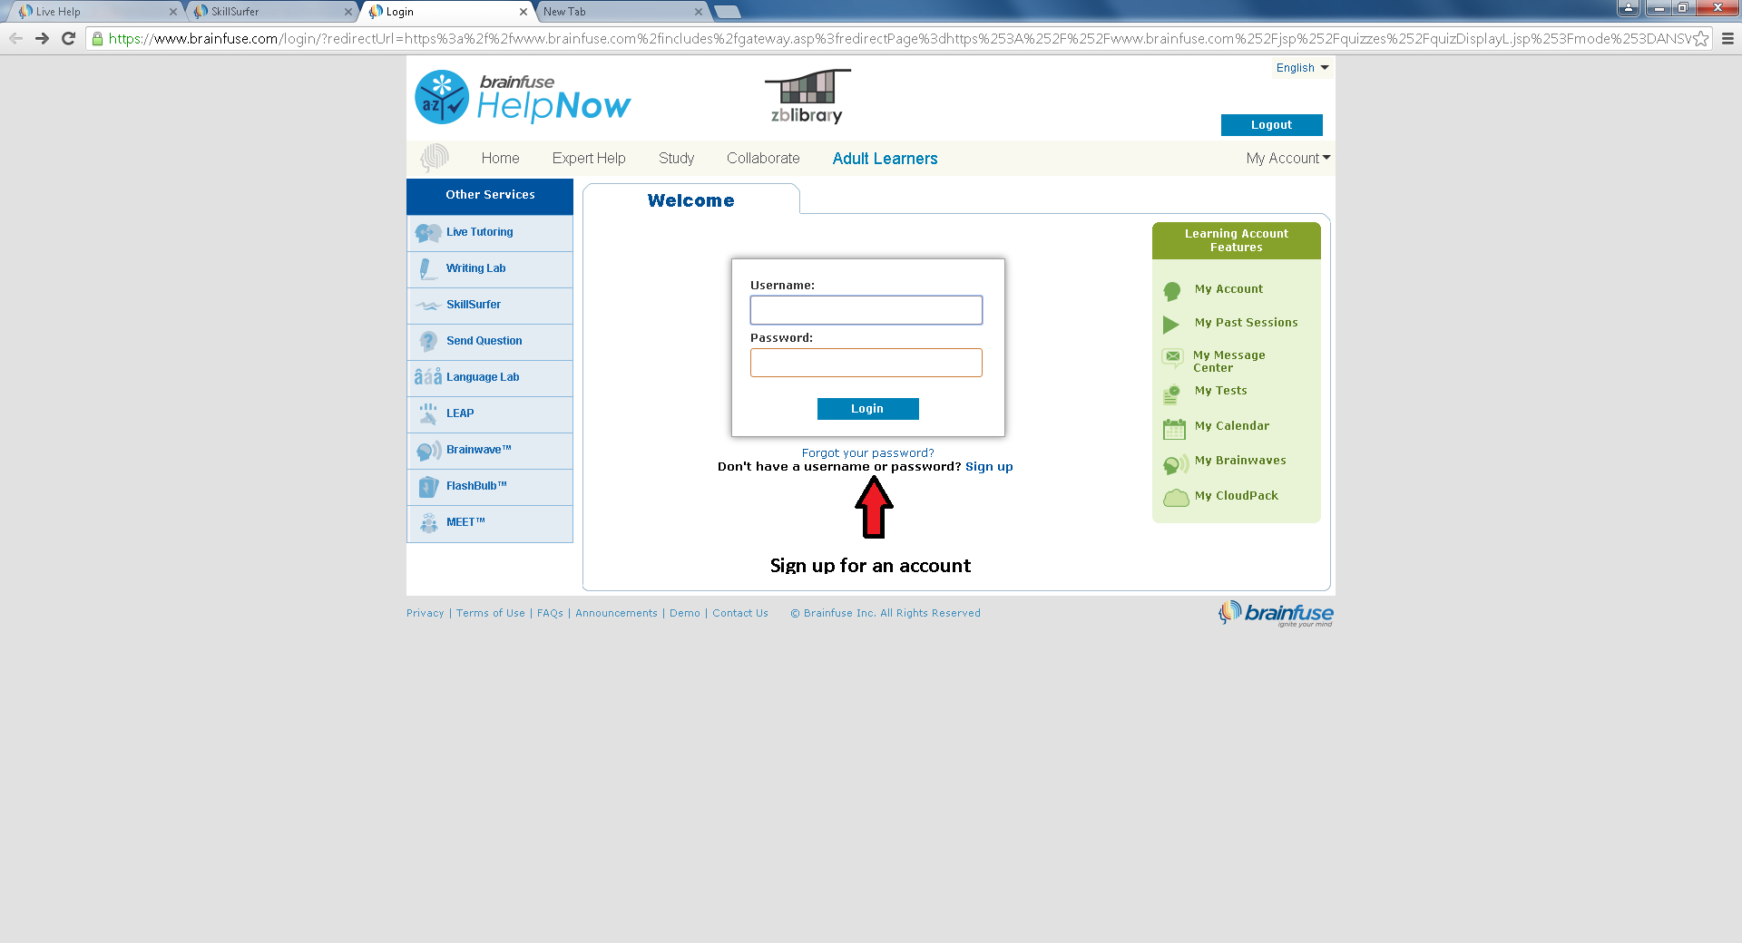

Slide 10
There are live tutors online who will ask you what you need help with etc. You and the tutor can have a conversation.

Slide 11
