Slide 1
Telegrams to Tweets: Creating More Engaged Citizens

Slide 2
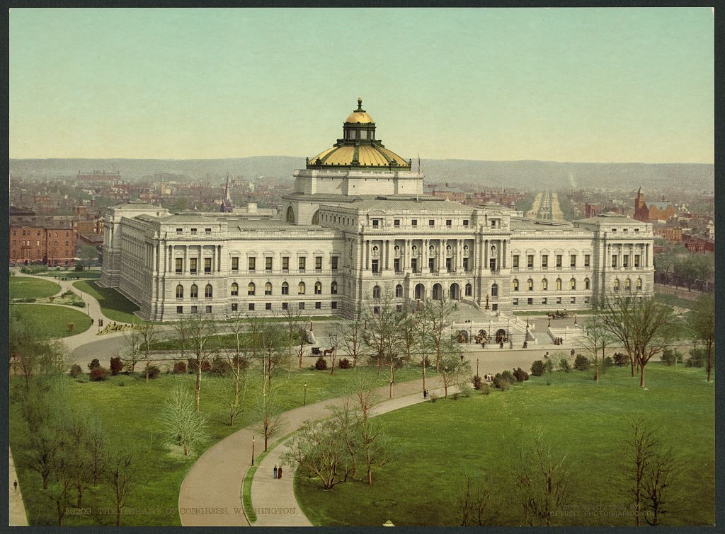
Library of Congress, Teaching with Primary Sources
Peggy O'Neill-Jones, Ed.D.
Director, Library of Congress Teaching with Primary Sources, Western Region
Metropolitan State
University of Denver
oneilljp@msudenver.edu
Kelly Jones-Wagy
Social Studies Teacher
Overland High School
Cherry Creek School District
kjones-wagy@cherrycreekschools.org

Slide 3
PRESENTATION OBJECTIVES
In the context of social media, learn to distinguish between media, forms, and tools and how they connect to learning | Examine ways in which you can use social media to engage students in historical thinking
Notes:
Kelly

Slide 4
Let’s Dig In

Slide 5
SOCIAL MEDIA
Instant Communication
Time and Geography Independent
Encourages Conversation
Promotes Community
Notes:
Peggy
Confusion of social media – All of the platforms #s of tools
5

Slide 6
MAKING SENSE
Examine ways in which you can use social media and primary sources to engage students in
historical thinking.

Slide 7
RE-THINKING THE FRAMEWORK: SOCIAL MEDIA IN THE CONTEXT OF SOCIAL STUDIES
Notes:
7

Slide 8
L
E
A
R
N
I
N
G
A
S
S
E
S
S
M
E
N
T
Media Type
Primary Sources
Expression Form
Social Media Tool
Historical Thinking
Knowledge Expression
Notes:
Kelly
Two ways to use social media: 1)have student express what they know and understand on social media. 2) evaluate social media as a primary source

Slide 9
MEDIA TYPE
 | MEDIA
 | TEXT
 | IMAGE
 | AUDIO
 | MOTION
Notes:
Peggy

Slide 10
PRIMARY SOURCE TYPE
 | MEDIA | PRIMARY SOURCE MEDIA TYPE
 | TEXT | Newspaper Articles, Letters, Journals, Manuscripts
 | IMAGE | Photographs, Political Cartoons
 | AUDIO | Music, Sound Recordings
 | MOTION | Video, Film, Animation
Notes:
Peggy

Slide 11
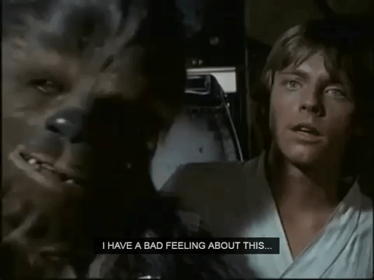
SOCIAL MEDIA TOOLS
 | MEDIA | CONCISE EXPRESSION | EXPANSIVE EXPRESSION
 | TEXT | Twitter: 140 Characters | Blogs: Unlimited Characters
 | IMAGE | SnapChat: Single Image | Instagram: Images Over Time
 | AUDIO | Embedded in other apps | iTunes: Unlimited Audio
 | MOTION | Gifs: Short Motion Images | YouTube: Unlimited Motion Images
Notes:
Peggy
#hashtagifyme

Slide 12
TELEGRAMS TO TWEETS
Examine ways in which you can use social media to engage students in historical thinking and inquiry.
First telegraphic message---24 May 1844
Morse, Samuel Finley Breese, 1791-1872.
What hath God wrought?
https://www.loc.gov/item/mmorse000107/
Notes:
Peggy and Kelly

Slide 13
Primary Source Analysis
Observe
Reflect
Question

Slide 14
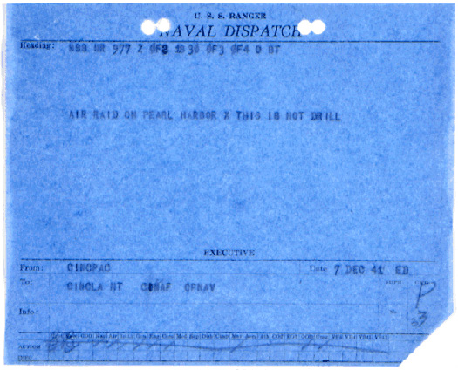
PRIMARY SOURCE
 | MEDIA | PRIMARY SOURCE MEDIA TYPE | CONCISE EXPRESSION
 | TEXT | Newspaper Articles, Letters, Journals, Manuscripts
https://www.loc.gov/item/today-in-history/december-07/
Notes:
14

Slide 15
HISTORICAL THINKING
Author, intent, audience, evidence, accuracy.
Notes:
Peggy

Slide 16
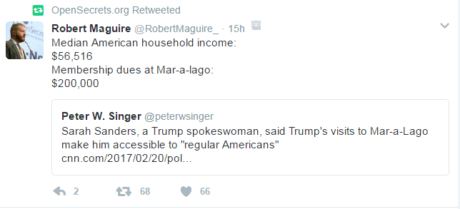
SOCIAL MEDIA AS A PRIMARY SOURCE
 | MEDIA | PRIMARY SOURCE MEDIA TYPE | CONCISE EXPRESSION
 | TEXT | Newspaper Articles, Letters, Journals, Manuscripts
Notes:
Kelly
Artifacts from earlier wars. Primary sources from this time and place.
16

Slide 17
HISTORICAL THINKING
Author, intent, audience, evidence, accuracy.
Notes:
Kelly

Slide 18
tpsteachersnetwork.org/register
Notes:
Continue the conversation. 60-65k info per day. unplug a child from the media they encounter. The info they choose to pay attention to. Consumers of info.
Presence on social media.

Slide 19
THOUGHTS? IDEAS?
Leave with ideas for using social media and primary sources to engage learners.

Slide 20
EXPRESSION FORM
 | MEDIA | EXPRESSION FORM
 | TEXT | Concise, Expansive
 | IMAGE | Concise, Expansive
 | AUDIO | Concise, Expansive
 | MOTION | Concise, Expansive

