Slide 1
Consider the Source
Fighting Fake News
Shaun T. Schafer, Ph.D.
Spring 2017

Slide 2
Fake News
What it is.
Where it came from.
Where it’s found.
What to do about it.

Slide 3
This used to be easy
For nearly three decades, Weekly World News provided a primer in fake news.
We all saw it at the grocery store, and we all knew it was fake.

Slide 4
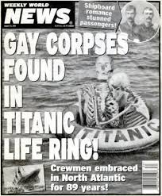
Really easy

Slide 5
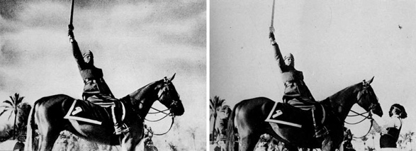
Fundamentals
Hoaxes and doctored stories have a long history.
The horse handler was removed to make Mussolini look more heroic.

Slide 6
Image Control

Slide 7
Detective Work
Researchers from the Library of Congress discovered that the image of Gen. U.S. Grant on horseback in front of his troops in Virginia City, Va., was actually a composite.
The head of Grant from a portrait.
The horseback body of Maj. Gen. Alexander M. Cook.
Confederate prisoners from the battle of Fisher’s Hill, Va., in the background.

Slide 8
Uncovered

Slide 9
The Process
Uncovering the Grant photo took extensive research of images and came more than a century after the Civil War.
We don’t usually have 100 or so years to ferret out fake news.
We have to do it on the fly.

Slide 10
Defining
Fake news is …
Misinformation
Propaganda
Hoaxes
Using social media
Driving web traffic

Slide 11
Misinformation
False or misleading information.
Often out of context.
Often originated with malice.
Designed to harm.

Slide 12
Propaganda
Ideas or statements that are often false or exaggerated and that are spread in order to help a cause, a political leader, government, etc.
Designed to aid a person or cause.

Slide 13
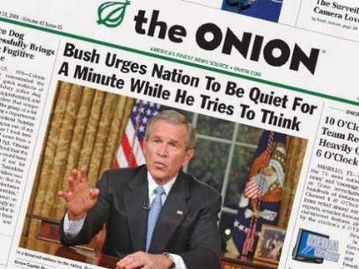
Hoaxes & Satire
An act intended to trick or dupe.
Something accepted or established by fraud or fabrication.
Designed to entertain.

Slide 14
Why It Matters
An informed electorate is key to the functioning of a democracy.
A head full of fake news is a corrosive as a body full of cheese puffs and cotton candy.
Neither is fit.
Neither makes good decisions.

Slide 15
The Fount
Audiences expect information for free.
Audiences expect information, and by extension news, to be everywhere.
Audiences are indiscriminate.
Audiences get what they pay for.

Slide 16
The Formula
Fake news mimics news.
It often looks like conventional reporting, a la The Onion.
Often has what appears to be sources.
Often relies on anonymous sources and hearsay.

Slide 17
The Filters
Information removed from reality.
Generations of reproduction in no time.

Slide 18
Lightning Quick
Spread relies on ignorance and confirmation bias.
Ignorance – I don’t know what I don’t know.
Confirmation bias – This fits with my beliefs, so it must be true.
Spread counts on clicks and shares.
“A lie can travel halfway around the world while the truth is still putting on its shoes.” Mark Twain, attributed 1919
“A lie will go round the world while truth is pulling its boots on.” – C.H. Spurgeon, 1859

Slide 19
What We Don’t Know
Ignorance can hurt.
Lack time to investigate.
Lack desire to investigate.
“Gossip is the Devil’s radio.”
Speaks to human nature.

Slide 20
Bias
“It isn't what we don't know that gives us trouble, it's what we know that ain't so.” Will Rogers
The echo chamber of confirmation bias.
Audiences loyal to information sources.
Audiences loyal to information that fits a schema.
The fact-free pronouncement.

Slide 21
The Truth is Out There
… And so is this …
Macedonian teens getting rich off of fake news.

Slide 22
Where It’s Found
Fake news tends to look like news.
Melissa Zimdars, professor at Merrimack College, compiled a list of fake news sites.
Posted and removed list because of social media backlash.

Slide 23
Repeat Offenders
Zimdars’ list of false, misleading, clickbaity and/or satirical sites numbered 858!
“If the story makes you REALLY ANGRY it’s probably a good idea to keep reading about the topic via other sources to make sure the story you read wasn’t purposefully trying to make you angry (with potentially misleading or false information) in order to generate shares and ad revenue,” Zimdars writes.
List: https://docs.google.com/document/d/10eA5-mCZLSS4MQY5QGb5ewC3VAL6pLkT53V_81ZyitM/preview

Slide 24
What to do?
Share responsibly
Verify
Consider the source

Slide 25
Responsibility
My Aunt Emma* shares everything that she likes.
She makes no attempt to confirm anything before she clicks.
I have blocked her posts on my Facebook news feed.
Don’t be Aunt Emma.
*Emma is not her real name. I have multiple aunties and I would like them to continue to be my friends. The name was changed to protect me.

Slide 26
Verification
It’s one of the oldest tools in our human relations toolkit.
Humans lead us to other humans, other documents and other sources.
What steps are made to verify information? In an age of hot links, this should be automatic.
Promote transparency

Slide 27
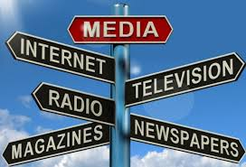
Consider the Source
Link to your sources.
Reserve anonymity only for the most vulnerable.
Consider why a source is a source.

Slide 28
A Simple Reminder
SATIRE
HOAXES
MISINFORMATION
Social Media
PROPAGANDA
REALITY

Slide 29
Closing Credits
This presentation meant spending a lot of time wallowing in some of the worst fake news and clickbait sites. It also built on the work of:
Melissa Zimdars, Merrimack College
Attorney and Imgur user Vanessa Otero
The Library of Congress
Clip Art
The Weekly World News archives
Collected works of Will Rogers
Collected works of Mark Twain
Openclipart.com
Getty Images

