Slide 1
“Inspire critical thinking…”
Reassess
Create
Analyze
Be Open-Minded
Research
Construct
Evaluate
When do WE offer our students the opportunity to truly critically think?
Notes:
Inspire critical thinking: this is one of our ultimate goals as a teacher and mentor in a school. If we can do this then we have succeeded because regardless of the content or problems that our students will encounter in the future this is the skill that will help them navigate the problem.
We ask our students to ANALYZE, CREATE, EVALUATE, RESEARCH (find an answer on their own), REASSESS (their learning), CONSTRUCT (maketheir own), and BE OPEN MINDED.

Slide 2
Project Based Learning
Buck Institute for Education: “develop deeper learning competencies required for success in college, career, and civic life.”
Stanford: “student teams develop and demonstrate their understanding of the problem by proposing one or more solutions, often designing, constructing and delivering a prototype.”
How do WE translate this style of learning into a “traditional” school environment?
Notes:
The answer comes with project based learning. According to the Buck Insititute for Education, a non-profit organization that provides teachers with PD around PBL (quote). But you hear all of the time that you cannot have student focus on projects in class because they will not be prepared for college. Yet Stanford has been promoting PBL for years and has many PBL environments. P5BL Lab (problem, project, product, process, people) Dept of Civil and Env. Engineering. We are “training” our students for college without allowing them the authentic experiences they will encounter in the college environment. We teach them to listen and question when allowed to question-to learn in the ways that we dictate they learn-often without options.

Slide 3
National History Day
The Answer to PBL in the “Traditional” Classroom
Notes:
PBL thus true engagement

Slide 4
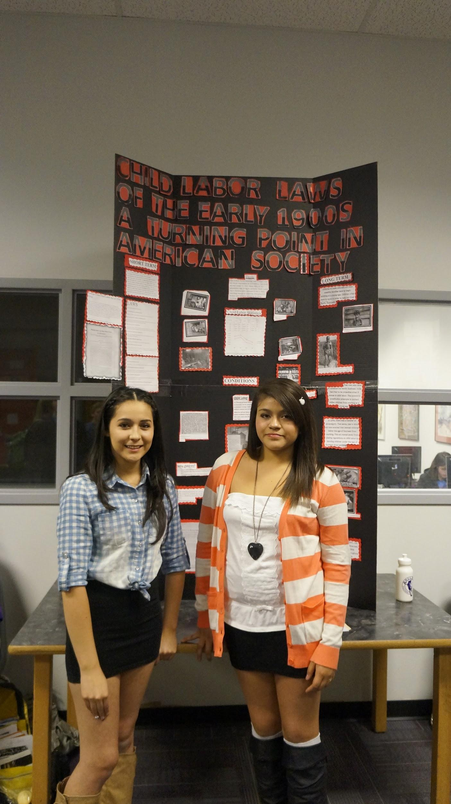
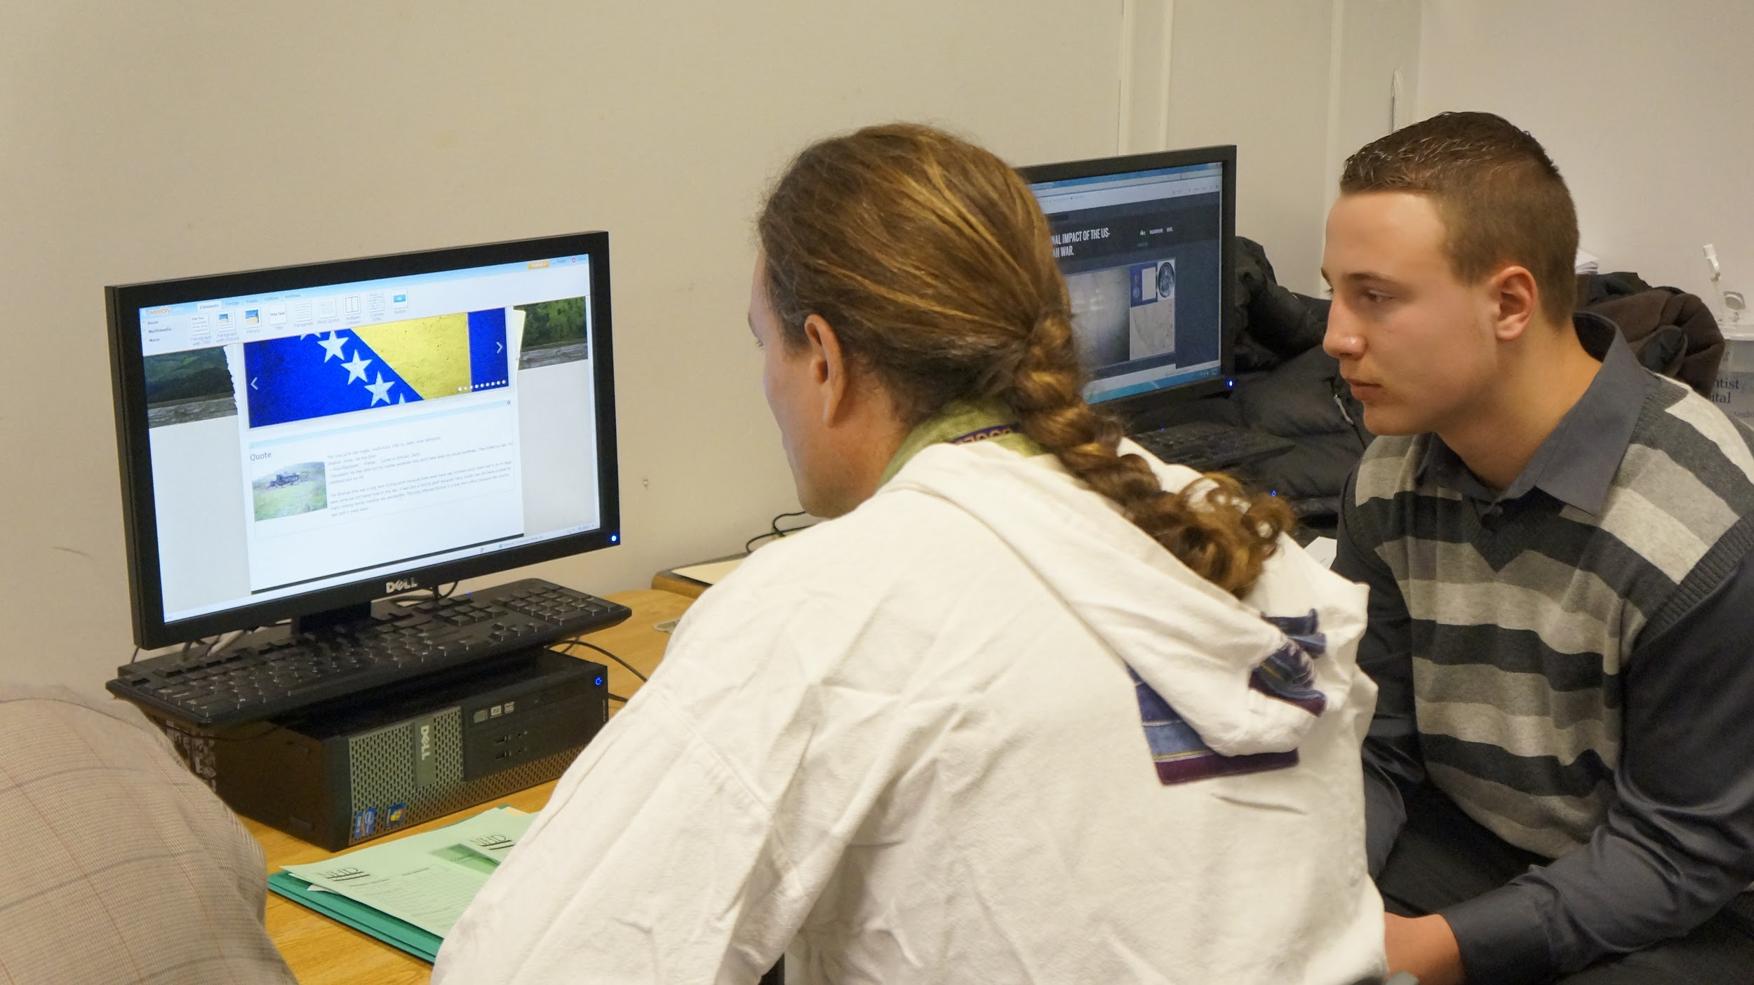
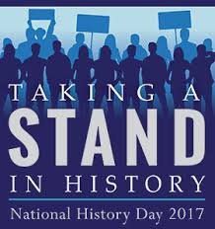
What is NHD?
A project based EXPERIENCE for students that asks them to:
Choose any topic that they are passionate about that directly relates to the national theme
Critically think about their topic and construct an argument with a comprehensive thesis statement
Research, analyze and assess information focusing on primary sources
Collaboratively create a project that brings their information to life
Build self confidence and pride by orally defending their arguments to judges in school based, regional, statewide and national competitions
Notes:
Emphasize: choice, interviews with community members for primary, importance of librarians, reaches all students, passion projects, absolutely doable in a traditional classroom

Slide 5
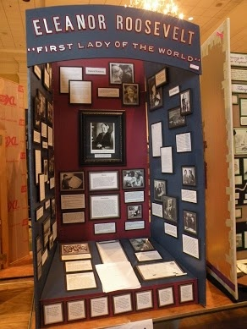
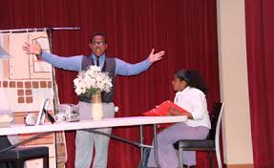
The Projects
Students can create:
An Exhibit
A Website
A Performance
A Paper
A Documentary

Slide 6
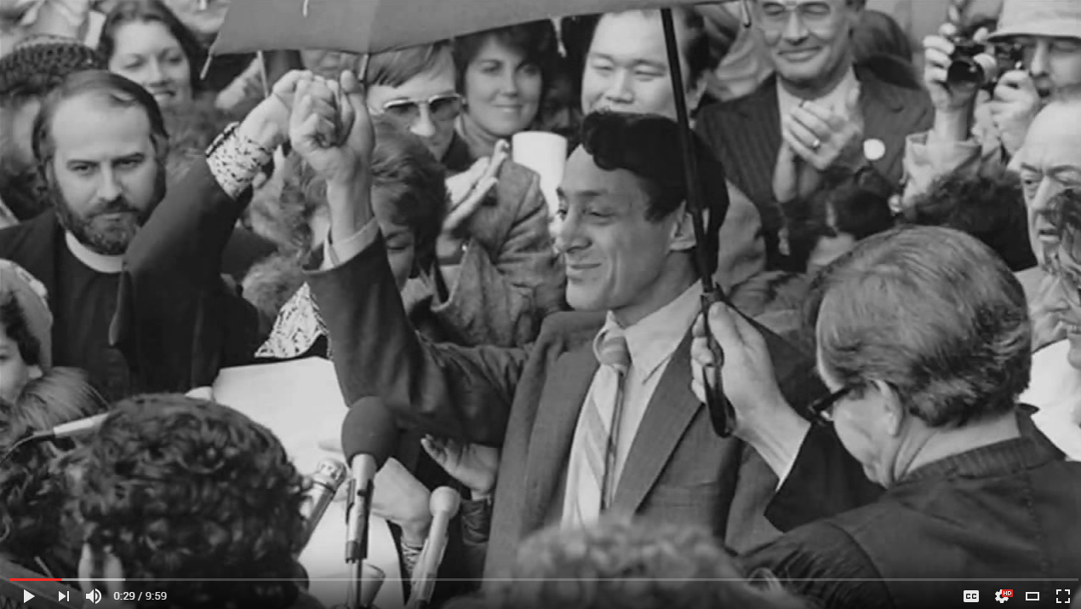
Watch: Harvey Milk Final Cut
Source: https://www.youtube.com/watch?v=P3978pOVNfk&feature=youtu.be

Slide 7
21st Century Skills
Thesis creation
Essay development
Analyzing sources and Questioning
Supporting an argument
Defending your thesis both in the project and orally
Collaboration
Innovation/Creativity
Technology/Problem Solving
Annotated Bibliography
CRITICAL THINKING

Slide 8
Highly Effective PBL...
Developing A Focused Question
Using Solid, Well-Crafted Performance Assessments
Allowing for Multiple Solutions
Enlisting Community Resources
Choosing Engaging, Meaningful Themes for Projects
Notes:
According to the Buck Institute that focuses on PBL training, highly effective PBL…
National History Day is this and story of Simon coming back from college “best thing I learned in high school, thing that prepared me the most for college”

Slide 9
Any Questions?
Kristen Lewis
720-561-2210
Kristen.lewis@bvsd.org

