Slide 1
Tayken on
The split

Slide 2
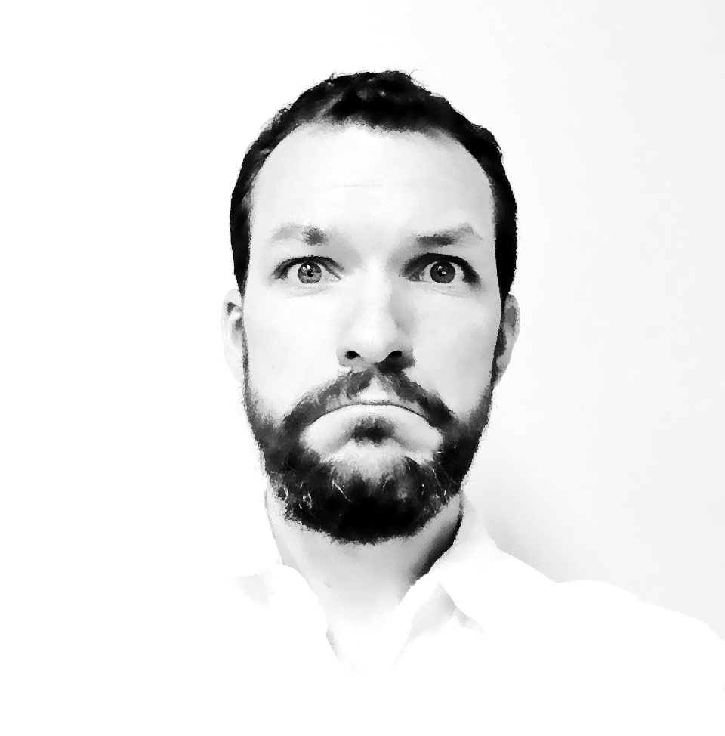
Hello!
I’m Taylor Kendal and I’d like to change your mind about... change
@taykendesign | taykendesign.com

Slide 3
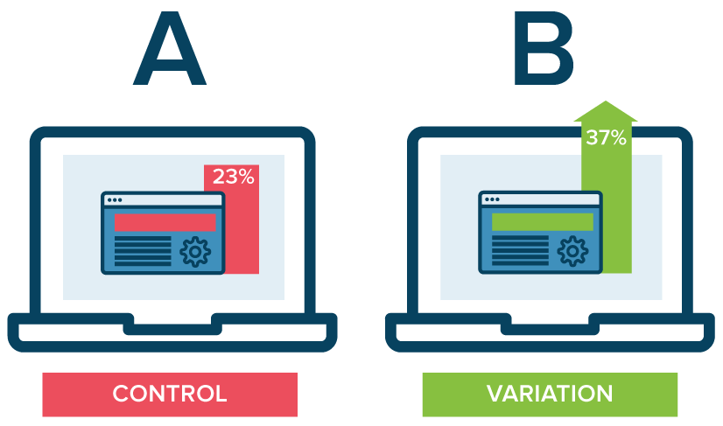

Slide 4
WHAT’s THE PLAN?
Nostalgic Introduction
The Split Splained
The why of the split
The how of the split
✔
✔

Slide 5
" I think there’s a world market for maybe Five "
~ Thomas Watson, chairman of IBM, 1943

Slide 6
" It wasn’t designed for commerce and doesn’t gracefully accommodate new arrivals "
~ Time magazine, 1994

Slide 7
" A shoe is no longer a finished product but an endless process of reimagining our extended feet. In the intangible digital realm, nothing is static or fixed. Everything is becoming. "
~ KEvin Kelly | The Inevitable, 2016

Slide 8
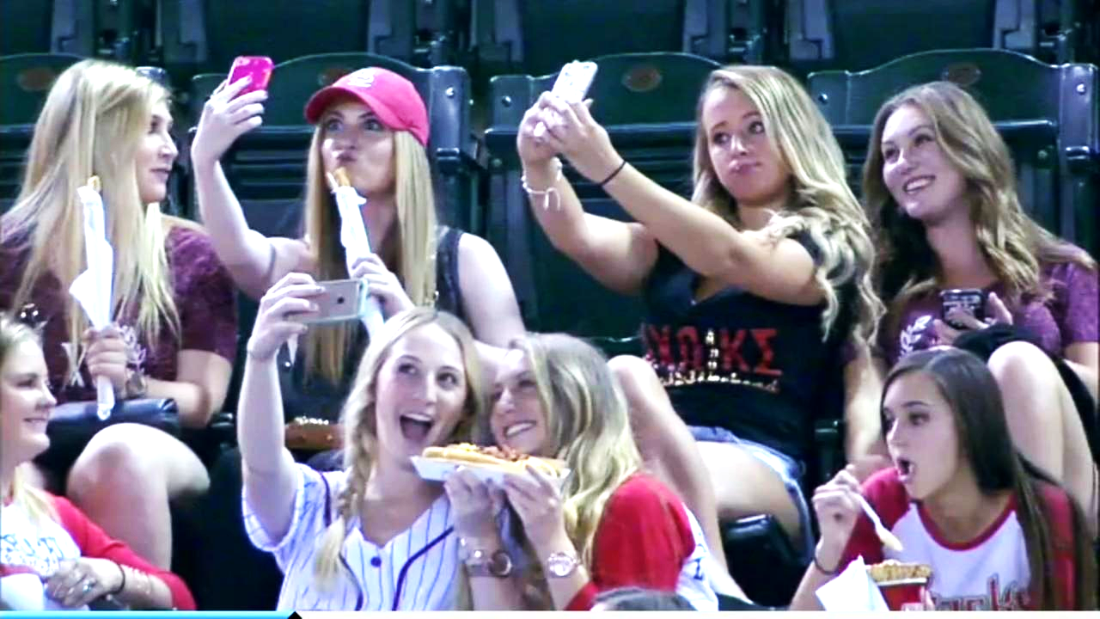

Slide 9
68 trillion

Slide 10
All in less
Than 8k days

Slide 20
THANKS!
@taykendesign | taykendesign.com

