Slide 1

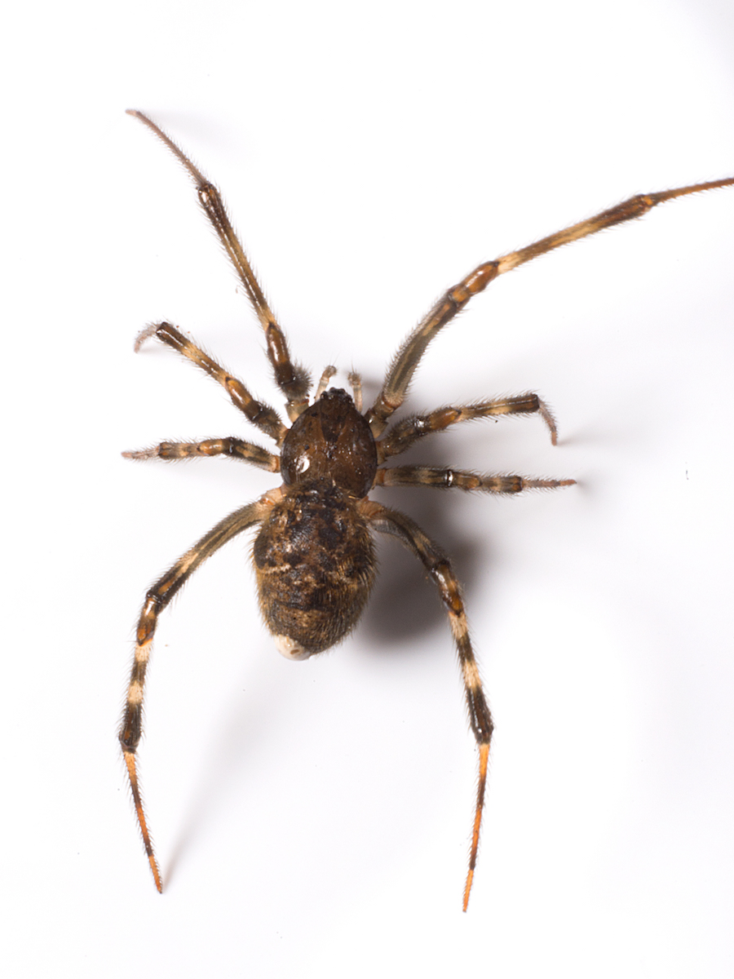
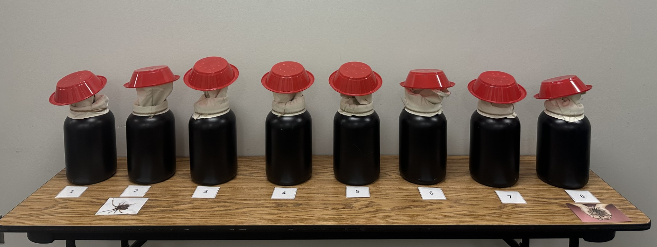

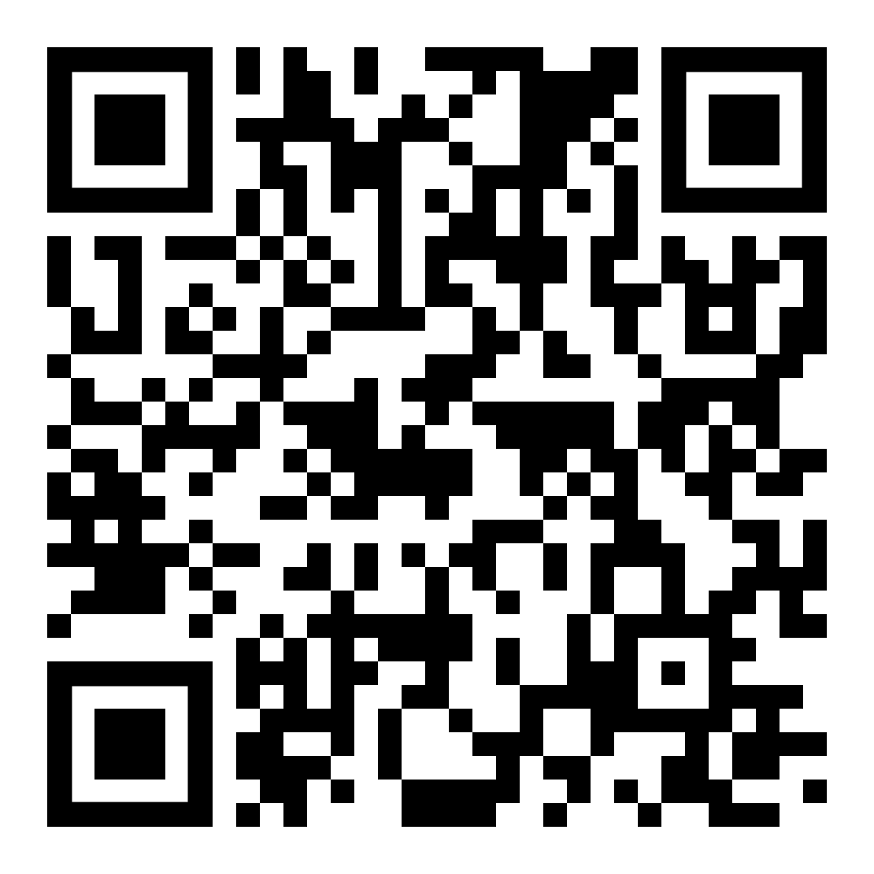
Does values matter?: The impact of a brief values intervention on approach behaviors.
Unlike two previous contamination anxiety studies, a brief values intervention did not increase approach behaviors in a spider related task. Why?
PRESENTER
Natalie Blackman
Background
Two studies found that a brief values-based intervention increased approach behaviors in a contamination anxiety-related Behavioral Approach Task (BAT; Hebert et al., 2021; Flynn & Hebert, 2022).
It is important to generalize these findings to other contexts.
The purpose of the study was to examine whether the same brief values intervention increase approach behaviors in a spider-related (BAT)?
Fe
Method
Measures
Fear of Spiders Questionnaire – Fear of Spiders (Avoidance and Fear). Higher scores reflect greater avoidance and fear.
Multidimensional Psychological Flexibility Inventory – Psychological Flexibility and Inflexibility. Higher scores reflect higher flexibility and inflexibility.
Procedure
Undergraduates (n = 174) were recruited using Sona and were randomly assigned to one of three conditions: values plus tickets, tickets only, or control.
All participants completed a series of questionnaires, then engaged in a spider-related BAT.
After completing the first BAT, participants in the values plus tickets condition were asked to identify a charity they care about and write for five minutes about why the charity was meaningful to them. Participants in the tickets only and control conditions waited for six minutes before being brought back into the room with the BAT.
When completing the BAT for a second time, values plus tickets participants were told that for each BAT step they completed, they would earn a ticket that would be entered into a drawing for a donation to the charity the wrote about. Tickets only participants were informed they could earn a ticket for each BAT they completed, and participants in the control group just completed the BAT the same way for a second time.
Results
There were no significant differences between conditions on psychological flexibility/inflexibility, fear of spiders and the Time 1 BAT at baseline.
There was not a significant difference between conditions on BAT discrepancy scores (i.e., BAT Time 2 – BAT Time 1).
Discussion
Unlike previous studies with contamination anxiety, differences based on condition were not found.
The use of spider-BATs may have caused meaningful differences in the effectiveness of the intervention.
Animal related stimuli are more readily related to adverse outcomes, compared to alternatives including contamination (Wiemer & Pauli, 2016).
53% of participants fell into the high spider fear group in the current study, which is greater another study with college students (34% see Seim & Spates, 2009).
Acceptance and Commitment Therapy (ACT) processes such as acceptance may be needed when participants face distressing stimuli (Wagener & Zettle, 2011).
NATALIE BLACKMAN, Ren-Baugher Mcintire, Tanner Jennings, Kiera Madison, Maureen Flynn

