Slide 1

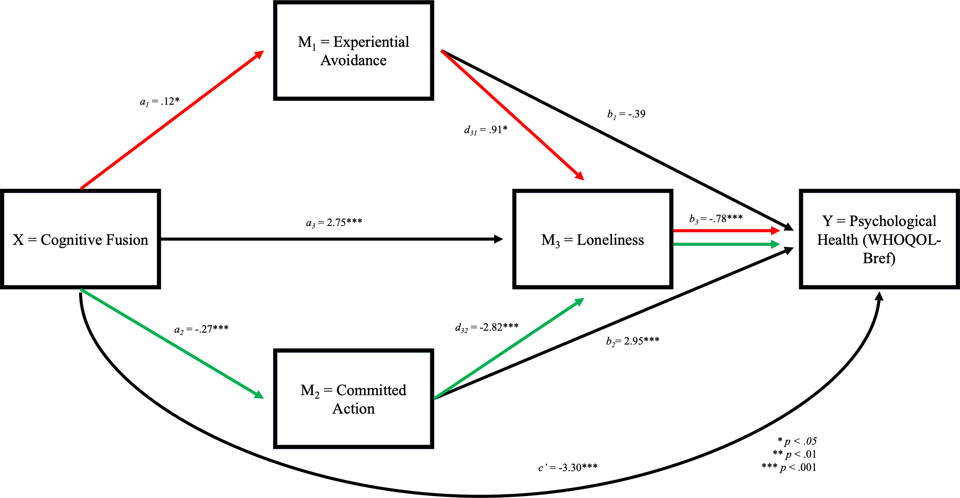



Cognitive Fusion, Loneliness, and Psychological Health Among College Students: The Roles of Experiential Avoidance and Committed Action as Mediators
Cognitive fusion (i.e., being entangled in thoughts) leads to lower levels of committed action (i.e., engagement in behaviors related to one’s values), which leads to higher levels of loneliness, which then leads to poorer psychological health and higher levels of depressive symptoms.
PRESENTER
Ren McIntire-Baugher
Background
Over half of college students are lonely, which is tied to poorer mental health.
It is important to examine variables that may influence this harmful association.
In a cross-sectional study, Castro et al. (2021) found that cognitive fusion led to higher levels of experiential avoidance and lower levels of committed action, which led to greater levels of loneliness, which then led to poorer psychological health.
The aim of the current study was to replicate Castro et al.’s (2021) study using a longitudinal design. We hypothesized that cognitive fusion increases depressive symptoms and decreases psychological health serially through experiential avoidance, committed action, and loneliness.
Method
Participants
Undergraduate students (n = 368).
Measures
Multidimensional Psychological Flexibility Inventory (MPFI) – Cognitive fusion, experiential avoidance, and committed action. Higher scores reflect a higher levels of that process.
UCLA Loneliness Scale (Version 3) – Loneliness. Higher scores mean higher levels of loneliness.
Center for Epidemiologic Studies Depression Scale –Revised (CESD-R) – Depressive symptoms. Higher scores indicate greater levels of depressive symptoms.
World Health Organization Quality of Life–BREF - Psychological health. Higher scores indicate greater psychological health.
Procedure
Participants completed online surveys three times, each two weeks apart.
Results
Cognitive fusion decreased psychological health serially through committed action and loneliness (-.58, 95% BOOT CI = -.91, -.32). However, cognitive fusion did not decrease psychological health serially through experiential avoidance and loneliness (-.09, 95% BOOT CI = -.23, .002).
Cognitive fusion increased depressive symptoms serially through committed action and loneliness (.31, 95% BOOT CI = .16, .52). However, cognitive fusion did not increase depressive symptoms serially through experiential avoidance and loneliness (.04, 95% BOOT CI = -.002, .11).
Discussion
Findings partially replicates the Castro et al.’s (2021) study – committed action but not experiential avoidance
Clinical implications - ensure ACT interventions attend to cognitive fusion and committed action processes when working with college students.
Future studies - impact of interventions targeting cognitive fusion and committed action on loneliness, depressive symptoms, and psychological health.
MCINTIRE-BAUGHER, R., Madison, K.M., Jennings, T.A., Blackman N.S., & Flynn, M.K.

