Slide 1

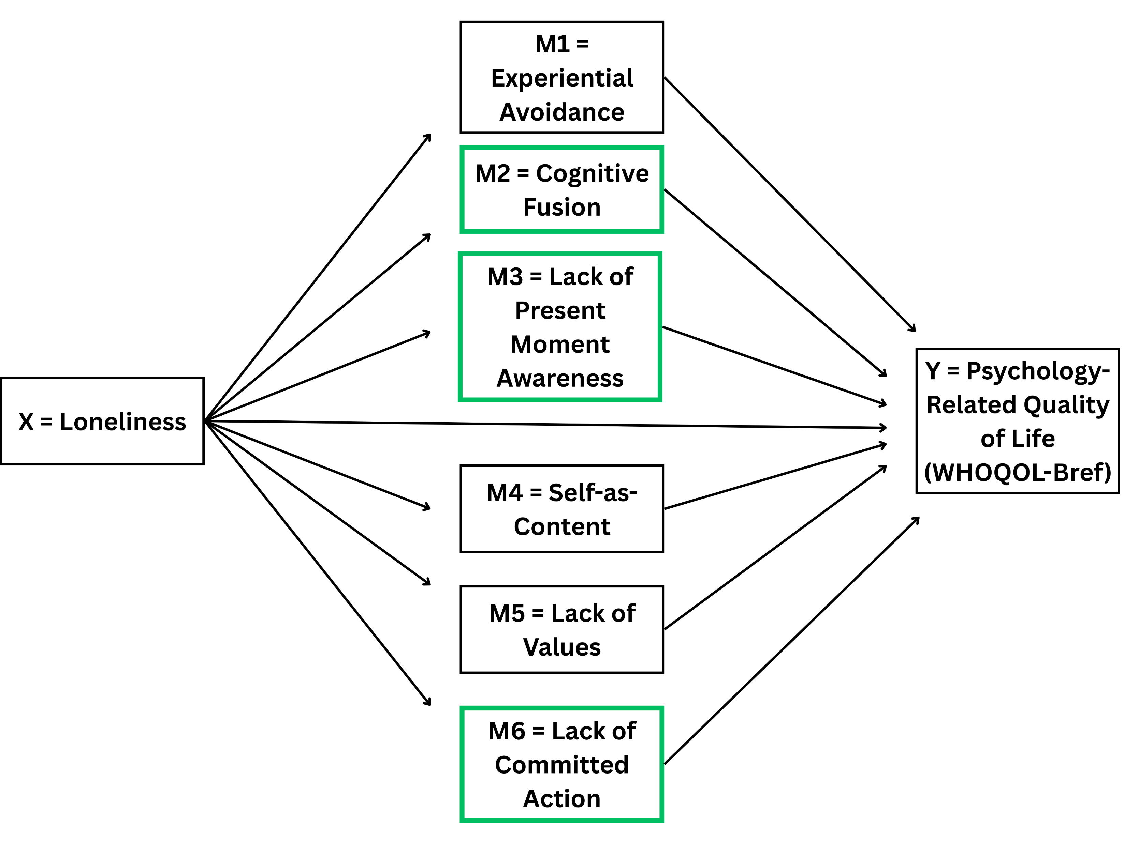
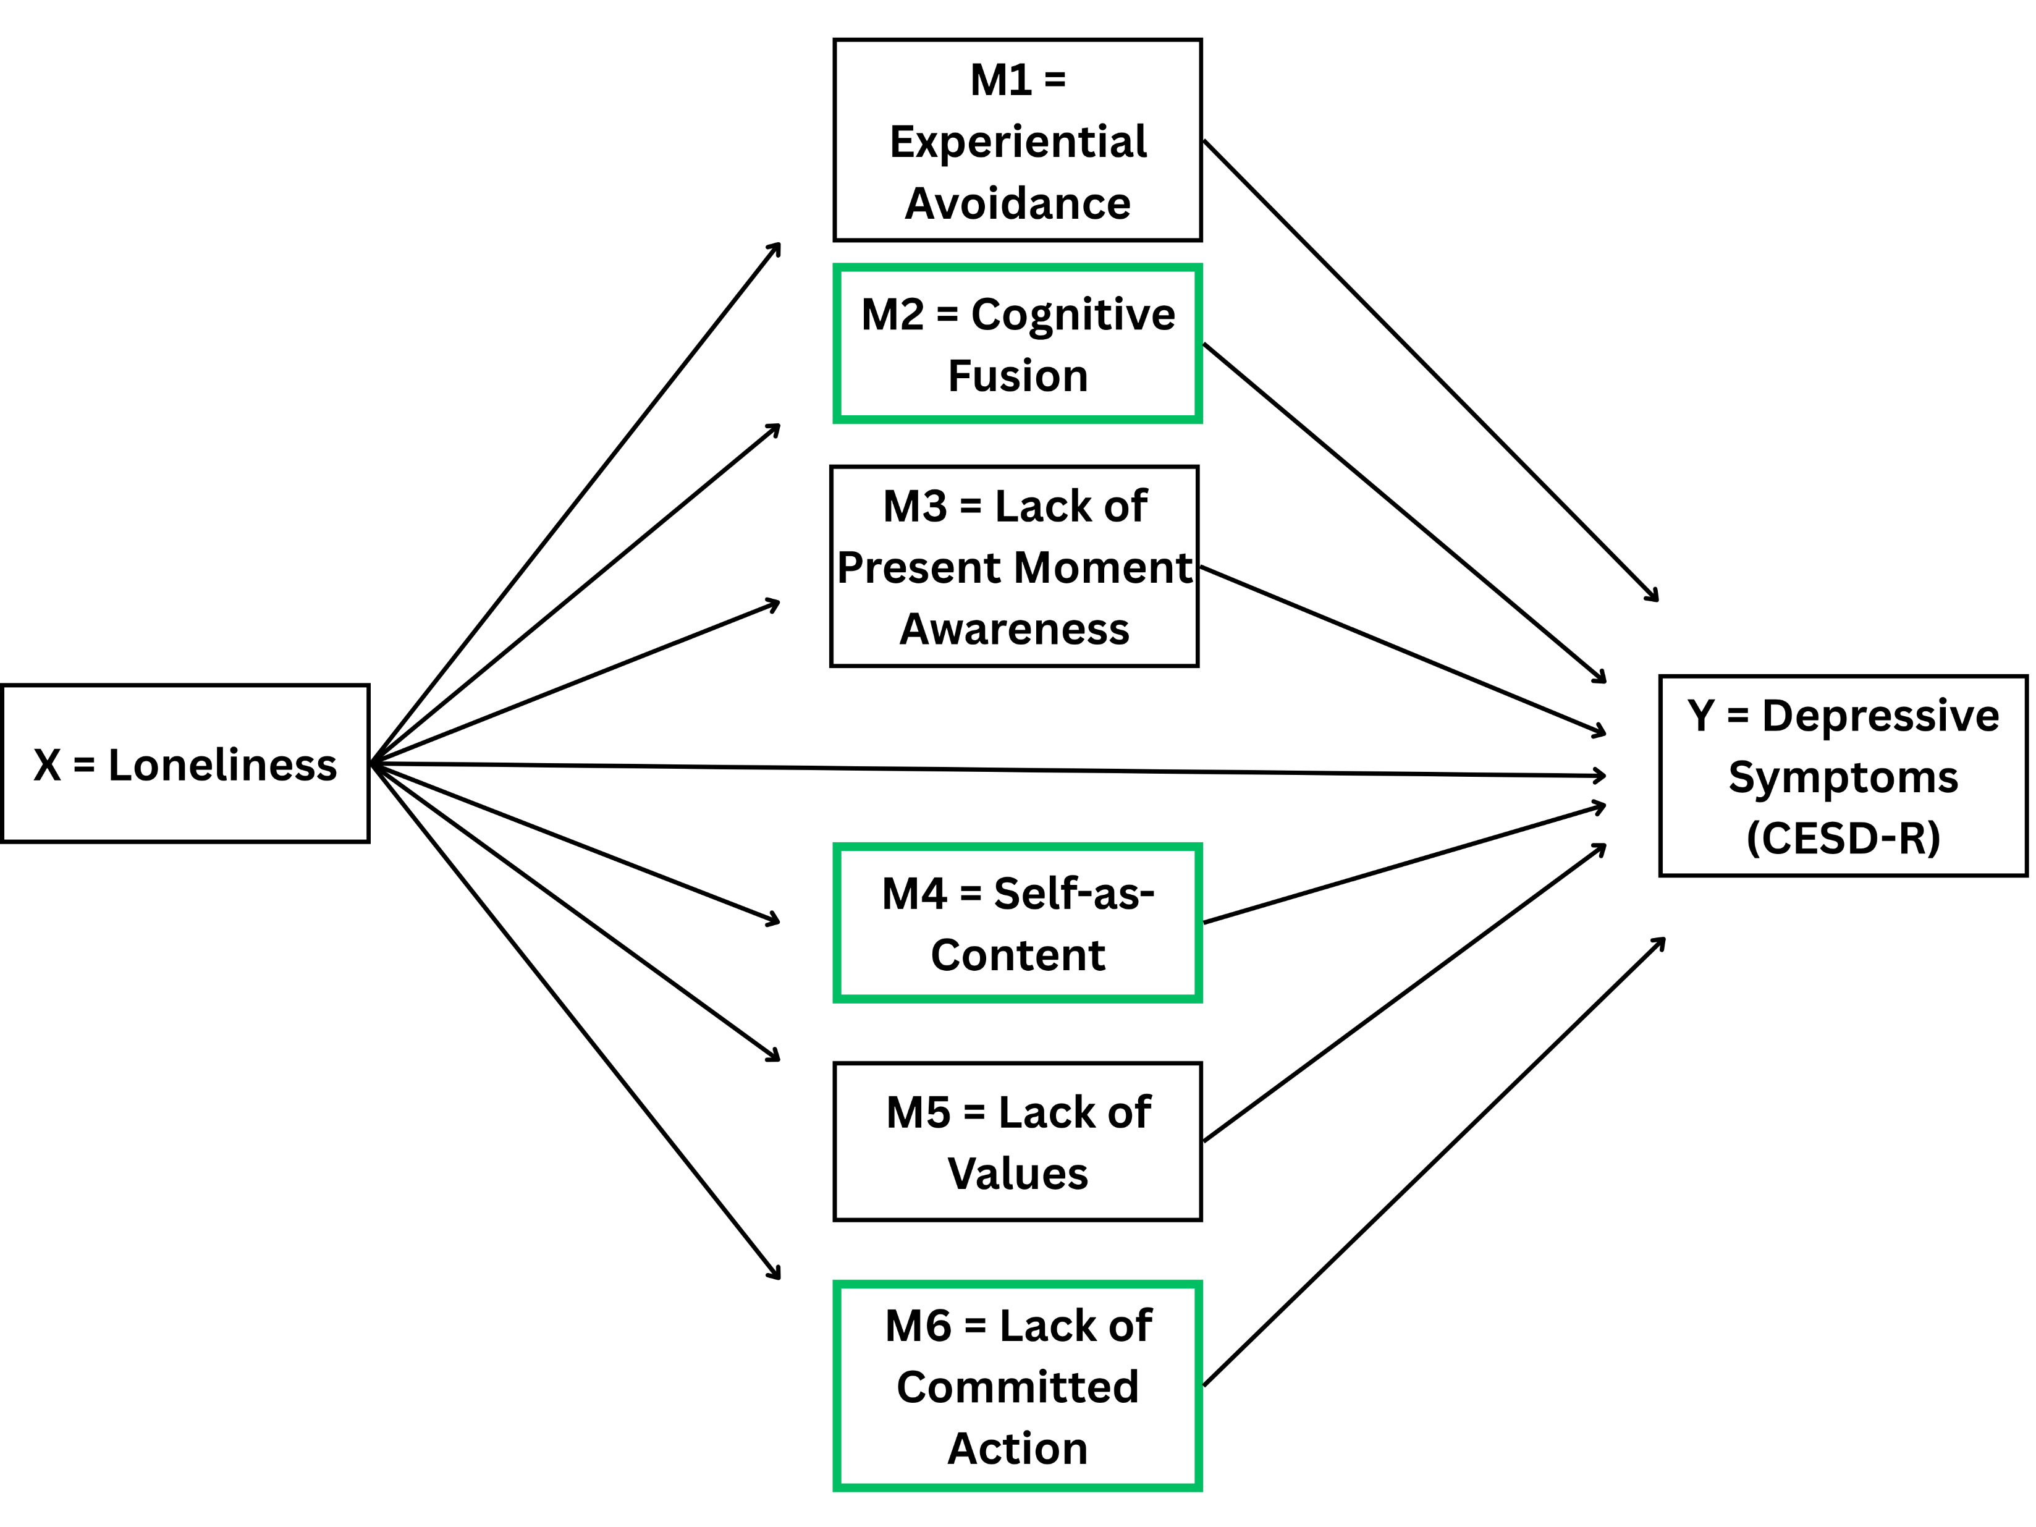


Exploring Mechanisms Linking Loneliness and Psychological Well-Being: The Role of Psychological Flexibility Processes
Loneliness leads to higher levels of fusion, self-as-content orientation, and lack of committed action, which then leads to greater depressive symptoms.
Loneliness leads to higher levels of cognitive fusion, lack of present moment awareness, and lack of committed action, which then leads to poorer psychological health.
PRESENTER
Tanner Jennings
Background
Loneliness has a high prevalence among undergraduate students (58%).
Loneliness is linked to substance abuse, depressive symptoms, and low quality of life.
It is important to identify mechanisms involved in the relationship between loneliness and psychological health.
The current study examines whether psychological inflexibility processes mediate the associations between loneliness and psychological health.
Method
Participants
The final sample consisted of 353 participants.
Measures
Multidimensional Psychological Flexibility Inventory – Psychological inflexibility processes. Higher scores mean higher level of that process.
UCLA Loneliness Scale – Loneliness. Higher scores reflect greater levels of loneliness.
Center for Epidemiologic Studies Depression Scale Revised – Depressive symptoms. Higher scores mean a higher prevalence of depressive symptoms.
World Health Organization Quality of Life Scale – Psychology-related quality of life. Higher scores indicate higher perceived quality of life.
Procedure
Undergraduate students were recruited through sona and received course credit for participation.
Participants took three surveys with a two-week gap between each survey.
Each survey measured loneliness, depression, quality of life, and psychological inflexibility processes.
a1 = .01*
b1 = 1.06
a2 =
.05***
b2 =
-2.85***
a3 =
.03***
b3 =
-2.23***
a1 = .01*
b1 = -.63
c’ = -.60***
Results
Results shows that loneliness influences depression indirectly through cognitive fusion (ab = .13, BOOT 95% CI = .06 to .21), self-as-content (ab = .08, BOOT 95% CI = .01 to .16), and lack of committed action (ab = .12, BOOT 95% CI = .03 to .21).
Results also demonstrated loneliness influences psychological health indirectly through cognitive fusion (ab = -.14, BOOT 95% CI = -.24 to -.04), lack of present moment awareness (ab = -.07, BOOT 95% CI = -.13 to -.02), and lack of committed action (ab = -.12, BOOT 95% CI = -.23 to -.03).
Discussion
This longitudinal study is the first to examine whether all psychological inflexibility processes mediate the associations between loneliness and psychological health and depression.
ACT clinicians enhance efforts to reduce cognitive fusion, self-as-content, and lack of committed action and present moment awareness to reduce the impact of loneliness on psychological health.
A limitation to be considered is the participants are all students in introductory psychology courses at one university.
Another limitation is the two-week interval may not be long enough to capture changes or stabilization in psychological health.
a4 =
.05***
b4 = -1.47
a2 = .05***
b2 =
2.69***
a5 =
.04***
b5 = -.73
a3 =
.03***
b3 = 1.00
b6 = -2.64*
a6 = .05***
c’ = .29***
a4 =
.05***
b4 = 1.64*
* = p < .05, ** = p < .01, *** = p < .001
a5 =
.04***
b5 = 1.21
TANNER JENNINGS, Natalie Blackman,
Ren McIntire-Baugher, Kiera Madison, Maureen Flynn
PrePrint
a6 = .05***
b6 = 2.60**

