Slide 1
Hyflex Learning

Slide 2
What is HyFlex?
F2F class schedule
Some students attend on Zoom
Emergency, remote option, NOT course modality!
Notes:
Hyflex classes in the SWK department are classes that are originally scheduled as face-to-face classes, but that have some students attending on Zoom for any reason. This may be because of COVID exposure, or other pandemic related personal or family issues.

Slide 3
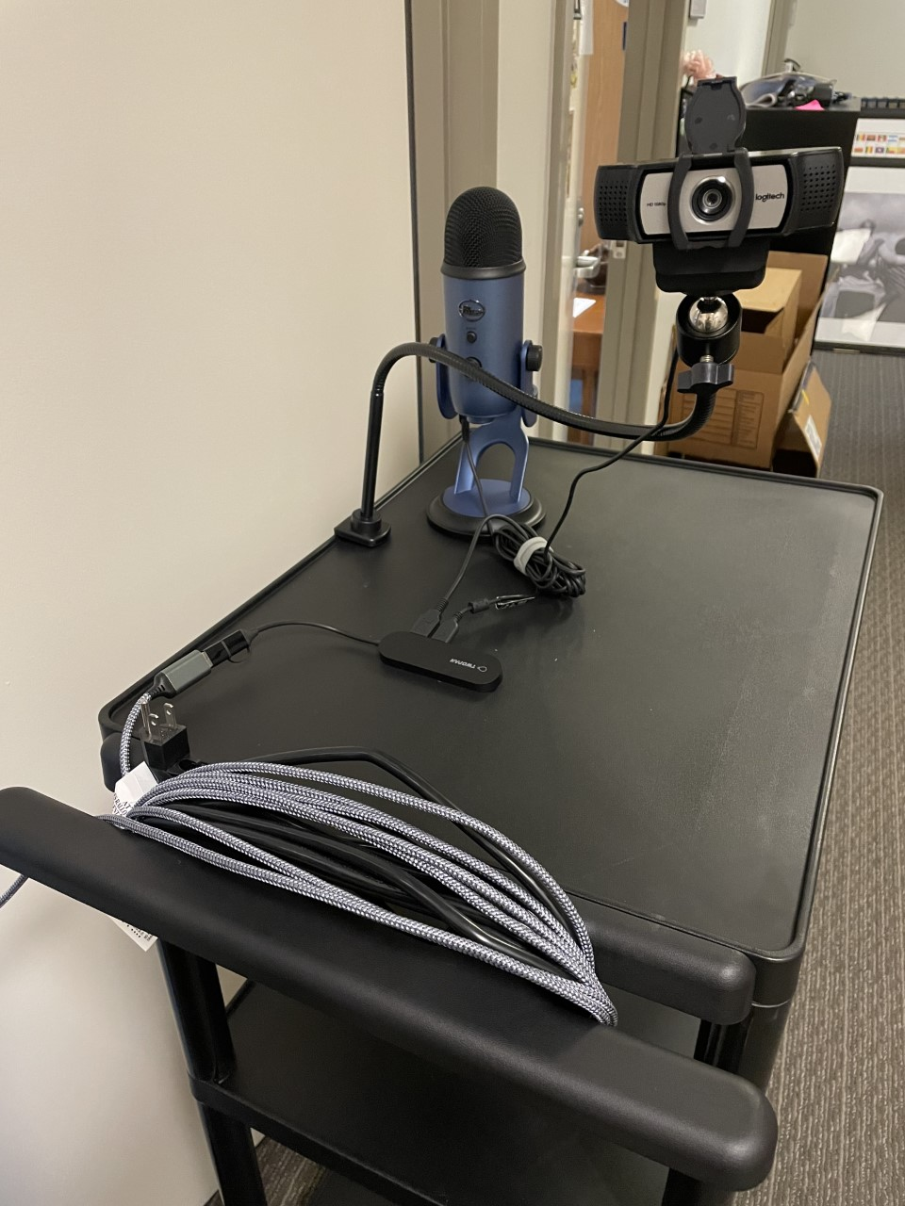
What Tools Are Available?
Tech Carts
Tech Backpack
Tech Classrooms (102, 212, 215)
Notes:
The department has provided several options for your classes:
Mobile tech carts include a webcam, microphone and speakers. These are easy to use within Central Classroom, and connect easily to your personal/work laptop.
The tech backpack is similar to the tech carts, but requires a little more effort to use. This is the best option if you are teaching in a building other than Central, or if you need a very portable option.
We have more and more tech classrooms; these rooms have great technical options for hyflex classes. IT can help provide training

Slide 4
Three Main Concepts:
Plan Technology
Build Community
Foster Engagement

Slide 5
Plan Technology
Extra Time
Communicate
Be Transparent
Notes:
Plan Technology
Extra Time
-Plan extra time at the beginning of class- it’s OK to start five minutes late if you need that space
-Plan extra time for each activity in class to give yourself a few minutes to manage both Zoom and Room activities
-Give yourself the gift of extra flexible time when presenting Hyflex classes; you are managing a lot, and it’s OK to take it slow!
Communication
-Communicate clearly about Zoom link and how to connect to the class. Do you expect cameras on? Will students be participating/speaking? Communicate clear expectations for online and face-to-face students.
-Reply promptly to emails during the week. Students might be stressed about class meetings, and you can alleviate that by communicating quickly with them during the rest of the week.
Be Transparent
-Be transparent about this course modality- it’s OK to let students know that this is an emergency, remote option, not a plan A
-Encourage Online students to actively participate when possible and to come prepared to participate in class. Their success depends on them, not just on you.
-Let students know that you care about them and their success, even if there are limitations to the technical aspects of this class format.

Slide 6
Build Community
Community Norms
Small Group Activities
Connect with Online
Notes:
Build Community
Community Norms
-Take time the first week or two of class to acknowledge the stress associated with our current circumstances, and to develop a plan with your students. What are your classroom COVID protocols? What options will students have if they are sick or need to miss class? What expectations do you both have around hyflex meetings? Talking this through in advance can alleviate anxiety and let students know what they can expect from you.
Small Group Activities
-Assign every class member a buddy who can be in touch with them if they miss class, and help them to be connected online.
-When doing small group activites online, remember to move online participants to a separate breakout room so they don’t hear the classroom noise
-If only 1-2 students online, have them join another in-person group on a personal laptop so they can connect.
Connect with Online Students
-At the beginning of class, welcome in-person and online students separately; make eye contact with the camera when you welcome online students.
-During lecture, turn the webcam to you, but during class discussions, turn the camera out to the class so students can see each other. Project the video of online students on the projector screen during class discussion so everyone can participate.
-Have times when you are just available to online students- have a long break so face-to-face students can have lunch or go outside to take their masks off, and spend part of that time with just online students. Or, end face-to-face class 10-15 minutes early so you can spend that time with online students.

Slide 7
Foster Engagement
Example Activity | In-Person Students | Zoom Students
Small group discussion | Meet with groups of 3-4, share out to the class later. | Use breakout rooms if at least three students, if only two students, have them join a group in the classroom,
Connect with Zoom
Use Inclusive Tools
Intentional Planning
Notes:
Foster Engagement
Connect with Zoom
-Assign an in-person student to check the chat and interject when there are questions and comments. This person can log in on their computer and MUTE everything so there isn’t an echo.
-Repeat in-person questions so Zoomies can hear them. Read out questions from the Zoom chat so everyone can hear.
Use Inclusive Tools
-Some classroom tools are engaging for everyone- try a tool like Kahoot, Poll Everywhere, Mentimeter, etc. where everyone in-person and online can participate on their personal device.
-Try using brainstorming tools like Google Jamboard, but ask in person students to participate as well; they might share devices if not everyone has one.
Intentional Planning
-As you plan your activities, try using a multi-column approach to intentionally include how you’ll engage with in-person and Zoom students.

Slide 8
Breathe! BE kind to yourself!
Notes:
This change in technology use to adjust for our current circumstances is challenging. Remember your biggest priorities: yourself, your students, your content. Whatever you do with technology is ENOUGH! It doesn’t have to be perfect

